Slide 1
8086 MICROPROCESSOR ARCHITECTURE

Slide 2
Have a look at these..
Microprocessor
An Integrated circuit that contains all the functions of a central processing unit of a computer.
What a Microprocessor will do ??
Fetches the instructions from the Memory
Decode the instructions
Execute those instructions

Slide 3
BUS
Set of conductors intended to transmit data or address or control information to different elements in a microprocessor.
Types of Buses:
Address Bus
Data Bus
Control Bus
Word Length/Size of internal Register of a Microprocessor
Number of bits a processor can process at a time.
Eg : Word length of 8085 Microprocessor is 8 bits

Slide 4
8086 Microprocessor
8086 microprocessor is a 16-bit Integer processor in a 40-pin package.
The type of package is DIP (Dual Inline Package).
8086 uses 20 address lines and 16 data- lines.
It can directly address up to 2²⁰ = 1 MB of memory.
8086 is designed to operate in two modes, i.e., Minimum and Maximum mode.
It does not have a RAM or ROM inside it. However, it has internal registers for storing intermediate and final results and interfaces with memory located outside it through the System Bus.

Slide 5
Features
Word Length : 16-bit
Memory Addressing Capacity : 1MB
Number of Pins : 40
Clock Speed : 5-8 MHz
Memory Segmentation
To increase execution speed and fetching speed , 8086 segments the memory.
Its 20-bit address bus segments memory into 16 64Kb segments.
8086 works only with four 64Kb segments within the whole 1Mb memory

Slide 6
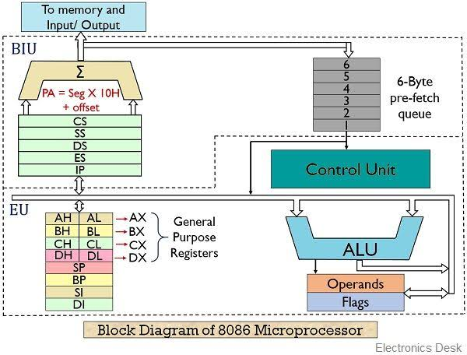

Slide 7
Functional Units of 8086
The 8086 Microprocessor contains two independent functional units.
Bus Interface Unit(BIU).
Execution Unit(EU).
BUS INTERFACE UNIT
The Segment registers ,instruction pointer and 6-byte instruction queue are associated with the Bus Interface unit(BIU).

Slide 8
Handles transfer of data and addresses.
Fetches instruction codes, stores fetched instruction codes in FIFO register set called a queue.
Reads Data from memory and I/O Devices.
Writes Data to memory and I/O Devices.
It relocates addresses of operands since its gets un-relocated operand addresses from EU.
The EU tells the BIU from where to fetch instructions or where to read data.

Slide 9
Functional Parts of BIU
Instruction Queue : When EU executes instructions, the BIU gets 6-bytes of the next instruction and stores them in the instruction queue and this process is known as instruction pre fetch. This process increases the speed of the processor.
Segment Registers : A Segment register contains starting address of a memory segment currently being used. The 4 Segment registers used in 8086 are
Code Segment Register (CS): Holds instruction codes of a program.
Data Segment Register (DS): Holds the data, variables and constants given in the program.
Stack Segment Register (SS): Holds addresses and data of subroutines. It also holds the contents of registers and memory locations given in PUSH instruction.
Extra Segment Register (ES): Holds the destination addresses of some data of certain string instructions.
Instruction Pointer (IP): Acts as a program counter, indicates the address of the next instruction to be executed.
An Adder Circuit is there to calculate the Physical Address of the Instruction to be fetched
Physical Address = Segment * 10 + OFFSET

Slide 10
After Receiving opcode of an instruction from the queue ,the Execution unit executes it. While Execution ,the BIU fetches the instruction codes from the memory and stores them in the queue parallelly.This makes processing faster.
Functional Parts of EU
General purpose Registers
Stake and Base pointers
Index Registers
ALU
Operands and Flags

Slide 11
General Purpose Registers: There are four 16-bit general purpose registers.
AX (Accumulator Register) : Used for instructions such as MUL,DIV et.,
BX (Base Register) : holds OFFSET address of a location in memory.
CX (Counter) : holds the count for various instructions.
DX(Data Register) : holds part of results from a multiplicand/dividend etc.,
Each of these 16-bit registers are further subdivided into 8-bit registers.
AX -> AH + AL
BX -> BH + BL
CX -> CH + CL
DX -> DH + DL

Slide 12
Pointer Registers
Stack Pointer(SP)
Base Pointer(BP)
Index Registers
Source Index(SI)
Destination Index(DI)
ALU : It handles all Arithmetic and Logical operations such as Addition, Subtraction, Multiplication, Division, AND, OR, NOT operations.
Flag Register : As it is a 16-bit register ,behaves like a flip-flop means changes states according to the result stored in the accumulator. It has 9 flags which are classified as Conditional and Control flags.

Slide 13
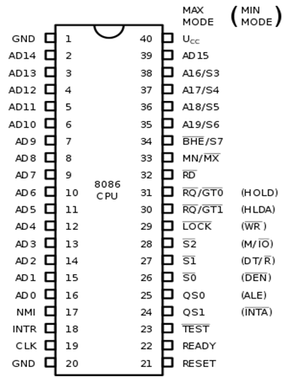

Slide 14
8085 microprocessor-PINS Description
AD0-AD15 (Address Data Bus): Bidirectional address/data lines. These are low order address bus. They are multiplexed with data.When these lines are used to transmit memory address, the symbol A is used instead of AD, for example, A0- A15.
A16 - A19 (Output): High order address lines. These are multiplexed with status signals.
A16/S3, A17/S4: A16 and A17 are multiplexed with segment identifier signals S3 and S4.
A18/S5: A18 is multiplexed with interrupt status S5.
A19/S6: A19 is multiplexed with status signal S6.

Slide 15
BHE/S7 (Output): Bus High Enable/Status
RD (Read): For read operation. It is an output signal. It is active when LOW.
Ready (Input): The addressed memory or I/O sends acknowledgment through this pin. When HIGH, it denotes that the peripheral is ready to transfer data.
RESET (Input): System reset. The signal is active HIGH.
CLK (input): Clock 5, 8 or 10 MHz.
INTR: Interrupt Request.
NMI (Input): Non-maskable interrupt request.
TEST (Input): Wait for test control. When LOW the microprocessor continues execution otherwise waits.
VCC: Power supply +5V dc.
GND: Ground.

Slide 16
Pin Description for Minimum Mode
In this minimum mode of operation, the pin MN/MX is connected to 5V D.C. supply i.e. MN/MX = VCC.
INTA (Output): Pin number 24 interrupts acknowledgement. On receiving interrupt signal, the processor issues an interrupt acknowledgment signal. It is active LOW.
ALE (Output): Pin no. 25. Address latch enable. It goes HIGH during T1. The microprocessor 8086 sends this signal to latch the address into the Intel 8282/8283 latch.
DEN (Output): Pin no. 26. Data Enable. When Intel 8287/8286 octal bus transceiver is used this signal. It is active LOW.
DT/R (output): Pin No. 27 data Transmit/Receives. When Intel 8287/8286 octal bus transceiver is used this signal controls the direction of data flow through the transceiver. When it is HIGH, data is sent out. When it is LOW, data is received.

Slide 17
M/IO (Output): Pin no. 28, Memory or I/O access. When this signal is HIGH, the CPU wants to access memory. When this signal is LOW, the CPU wants to access I/O device.
WR (Output): Pin no. 29, Write. When this signal is LOW, the CPU performs memory or I/O write operation.
HLDA (Output): Pin no. 30, Hold Acknowledgment. It is sent by the processor when it receives HOLD signal. It is active HIGH signal. When HOLD is removed HLDA goes LOW.
HOLD (Input): Pin no. 31, Hold. When another device in microcomputer system wants to use the address and data bus, it sends HOLD request to CPU through this pin. It is an active HIGH signal.

Slide 18
Pin Description for Maximum Mode
In the maximum mode of operation, the pin MN/¯MX is made LOW. It is grounded.
QS1, QS0 (Output): Pin numbers 24, 25, Instruction Queue Status.
QS1 | QS0 | Operation
0 | 0 | No operation
0 | 1 | 1st byte of opcode from queue.
1 | 0 | Empty the queue
1 | 1 | Subsequent byte from queue

Slide 19
S0, S1, S2 (Output): Pin numbers 26, 27, 28 Status Signals. These signals are connected to the bus controller of Intel 8288. This bus controller generates memory and I/O access control signals.
S2 | S1 | S0 | Operation
0 | 0 | 0 | Interrupt acknowledgement
0 | 0 | 1 | Read data from I/O port
0 | 1 | 0 | Write data from I/O port
0 | 1 | 1 | Halt
1 | 0 | 0 | Opcode fetch
1 | 0 | 1 | Memory read
1 | 1 | 0 | Memory write
1 | 1 | 1 | Passive state

Slide 20
LOCK (Output): Pin no. 29. It is an active LOW signal. When this signal is LOW, all interrupts are masked and no HOLD request is granted. In a multiprocessor system all other processors are informed through this signal that they should not ask the CPU for relinquishing the bus control.
RG/GT1, RQ/GT0 (Bidirectional): Pin numbers 30, 31, Local Bus Priority Control. Other processors ask the CPU by these lines to release the local bus.
In the maximum mode of operation signals WR, ALE, DEN, DT/R etc. are not available directly from the processor. These signals are available from the controller 8288.

